Slide 1


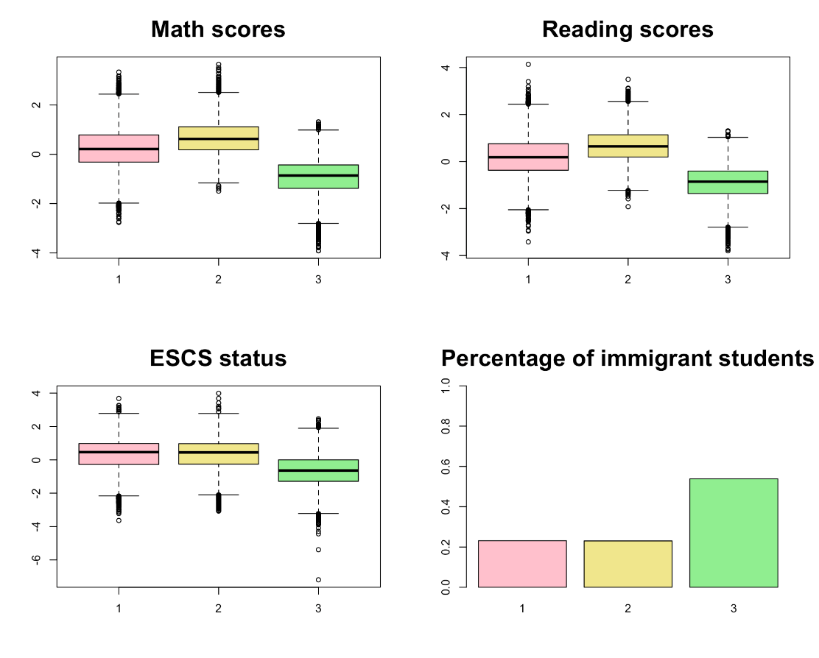
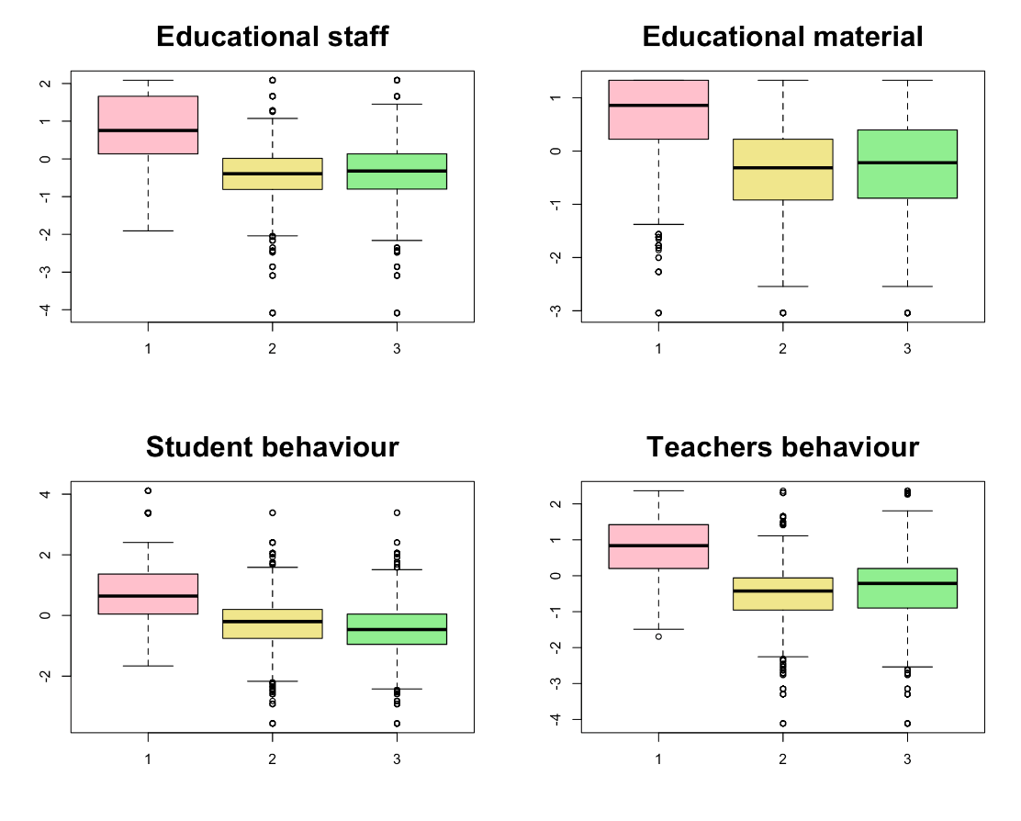
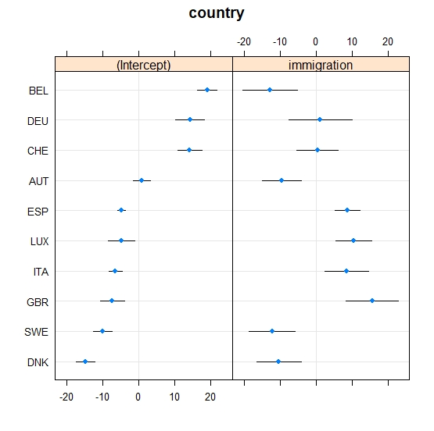
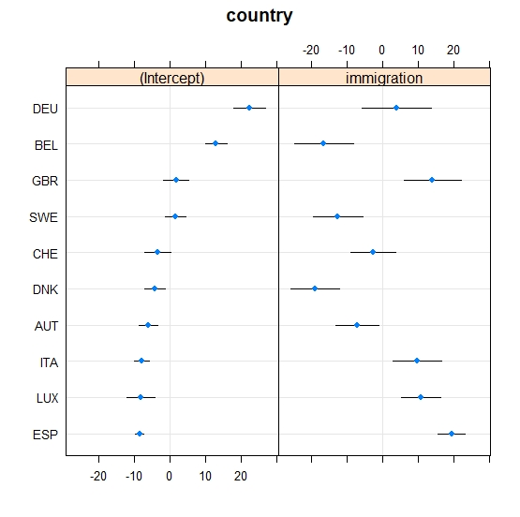
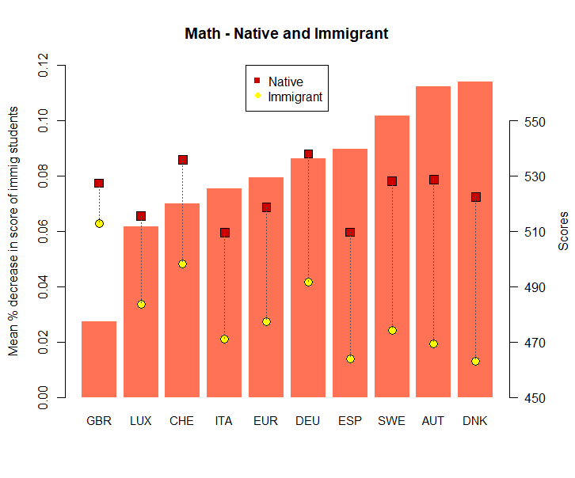
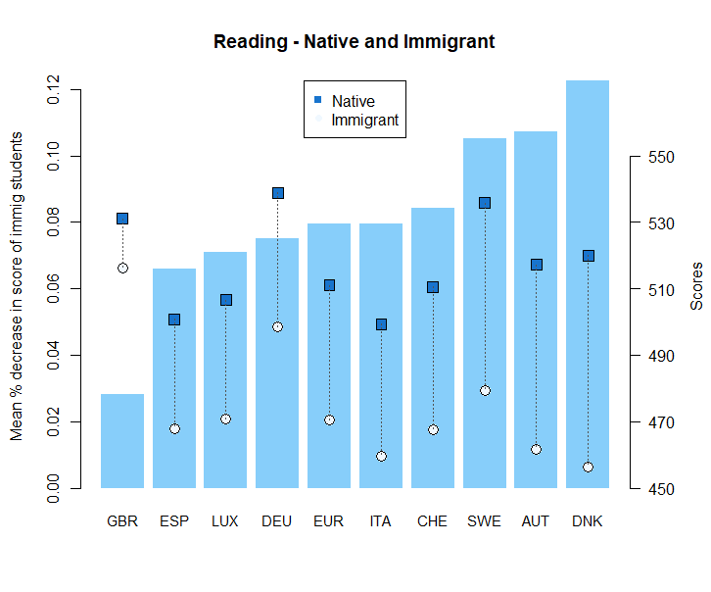
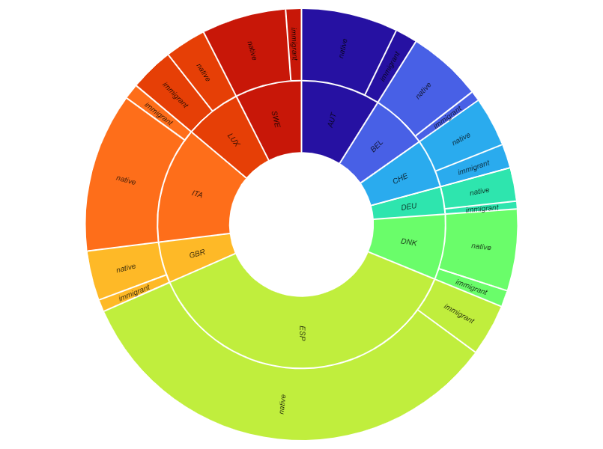
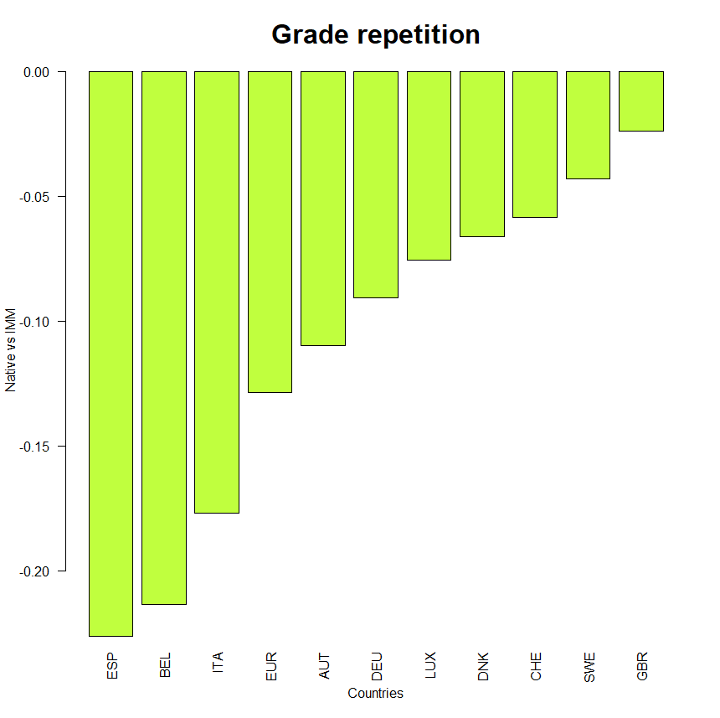
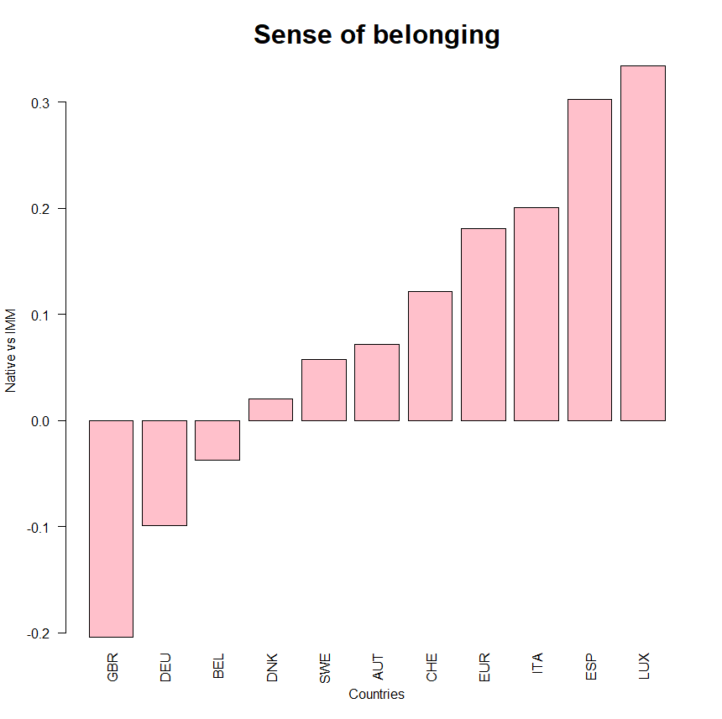
Immigrant students in Europe suffer from lower grades: some social and scholastic features are the key to explain it
Applied Statistics – Politecnico di Milano 2021/2022
ABSTRACT
Clustering
Investigating the dataset through k-means we identified 3 clusters of students.
The cluster with the worst math and reading scores contains 54% of the total number of immigrants, while the best contains only 23% of them.
Moreover, the clusters show that most immigrant students attend poorer schools with a shortage of material and staff, and a school climate that hinders learning.
Linear Models
To find the features mainly responsible of scholastic success we focused on three datasets: our complete dataset, Great Britain as an example of a country with good integration, and Denmark as one with more integration issues.
For immigrant students some of the main negative regressors are: not speaking the country’s language at home, having parents who are not highly educated and being bullied at school.
Moreover, schools with a shortage of educational material and staff influences their students’ achievements, especially if they are immigrant since they might need additional attention from teachers.
From the separate analysis of Great Britain, we noticed that ‘immigration’ and most of its interaction effects were not significant anymore, as expected. The key factors are schools’ resources and ESCS status.
On the contrary, in Denmark being an immigrant has a strong negative effect, worsened by the interaction with other covariates such as the student-teacher ratio in schools and the emotional status of the students.
High School years are a fundamental stage of development for everyone, and it is in the interest of every country to ensure that all students have access to the best possible education and are well integrated into the social system.
We analyzed data related to students of 15 years of age coming from European countries which have a significant number of immigrant students. We observe that immigration is a huge factor limiting foreign students from achieving the same results of their native peers. This trend is common to all to most countries across Europe, but some worse than others.
In this study we aimed at investigating quantitatively the reasons behind these differences.
DNK math | Worse Schools | Better Schools
emo_sup | -0,2137 | -0,2131 *
class_size | 0,1340 *** | 0,4796 ***
stud_teach_ratio | 0,0065 *** | 0,1527 ***
short_edu_mat | -1,1037 *** | -0,4795 ***
short_edu_staff | 0,0698 | -0,6047 ***
stu_behav | 0,3716 * | -1,5763 ***
teach_behav | 0,3021 | 0,5376 ***
ESCS_status | -0,2458 | 0,5188 ***
immigration | 0,5500 * | -0,3291
GBR math | Worse Schools | Better Schools
fear_failure | -0,1023 | 0,1595 *
stud_teach_ratio | -0,2209 *** | -0,1460 ***
short_edu_mat | 0,5528 *** | 0,4548 ***
short_edu_staff | -0,0284 | -0,9470 ***
stu_behav | 0,3217 ** | -1,0387 ***
teach_behav | -0,4717 *** | 0,7049 ***
ESCS_status | -0,3464 *** | 0,8281 ***
GBR read | Worse Schools | Better Schools
fear_failure | -0,0092 | 0,1815 *
belonging | 0,0571 | 0,2045 *
bullied | 0,2552 * | 0,0101
teacher_support | 0,3546 ** | 0,0312
class_size | 0,1162 *** | -0,0728 ***
stud_teach_ratio | -0,3541 *** | -0,1035 ***
short_edu_mat | 0,2069 *** | 0,6265 ***
short_edu_staff | -0,0264 | -1,0375 ***
stu_behav | 0,8385 *** | -1,2998 ***
teach_behav | -0,3180 | 1,3167 ***
DNK read | Worse Schools | Better Schools
belonging | 0,2816 * | 0,1314
teacher_support | -0,3892 * | -0,0440
stud_teach_ratio | 0,0208 *** | 0,0552 ***
short_edu_mat | -0,8306 *** | -1,3913 ***
short_edu_staff | 0,5502 *** | -0,2738
teach_behav | 0,0440 | -0,6213 **
ESCS_status | 0,4883 * | 0,3351
INTRODUCTION
Our dataset is based on some questionaries’ answers of students, their parents, and their school’s staff, regarding both their scholastic knowledge and social and psychological conditions.
After exploring the dataset and analyzing it through MANOVA tests and Clustering methods, we focused on students’ scores in Math and Reading. Indeed, native and immigrant students show consistent differences in term of their results.
Then through linear models, we identified the main covariates responsible of the students scores to understand where to act to help struggling students, often immigrant, in the most effective way.
Finally, through Linear Mixed Models we clustered schools based on their contribution to the scores and using Multinomial Logistic Regression we identified the key characteristic which allows the “better” schools to help their students.
Linear Mixed Models
Since our data offers some grouping possibilities (by country and by schools) we extended our linear models into linear mixed models aggregating the observations firstly by countries, adding a random slope associated with the variable immigration.
Secondly, we grouped the datasets of Great Britain and Denmark by schools, to observe what do schools in these countries do differently to help their students through Multinomial Logistic Regression in the next section.
The random effect given by the country grouping is significant and adding the immigration random slope increases its relevance. The Percentage of Variance explained by the Random Effect (PVRE) goes from 2.3% to 4.4% for math and from 1.5% to 4.3% for reading. By plotting the random coefficients of the two models, it’s clear how being an immigrant living in Great Britain has a positive effect on the school performances while living in Denmark has a negative one with respect to the mean.
MANOVA
To confirm the qualitative results observed through clustering we performed MANOVA tests on the main features of interest.
For all countries (except Great Britain) we found statistical evidence at level 95% that immigrant students have lower mean scores in both Math and Reading. By ranking the differences in scores, we see that Great Britain is first while Denmark is last.
Similar differences are found also for other features such as ESCS status, sense of belonging in school, grade repetition percentages. On the other hand, weekly times spent studying are consistently higher for immigrant students compared to native, which excludes lack of commitment as the motivation behind lower scores.
CONCLUSION
Through our analysis we highlighted the differences between immigrant students and native students and provided the main factors which drive their scholastic success.
The main findings were that immigrant students have lower scores while studying significantly more, they often have a lower social status, lower academic support, higher rates of grade repetition and lower sense of belonging in schools.
These results confirm the main studies on the subject and highlight a problem in integration of many countries in the European area.
What can schools do to improve?
Provide information to immigrant parents on the schooling options available for their children and help parents to overcome financial and/or logistical barriers to access the school of their choice. Limit the extent to which advantaged schools can select students based on socio-economic status.
Retain and attract more advantaged students in schools that also host immigrant students. For example, schools in disadvantaged areas can make their curricula more appealing to students from across the socio-economic spectrum by offering special mathematics, science and/or art courses.
What can countries do?
Integrate language and subject learning from the earliest grades. While language training is essential, it should be offered in addition to, not instead of, regular course work.
Help teachers to identify students who need language training.
Reduce the use of grade repetition. Instead, identify struggling students early and offer them extra support. For immigrant students, identify language-training needs early.
MATERIALS & METHODS
Data Selection
Starting from the data of Pisa’ OECD program of 2018, which contains student and school answers to standardized questionnaires, we restricted our analysis to 10 selected countries which had a sufficient sample of immigrant students: Austria, Belgium, Switzerland, Germany, Denmark, Spain, Great Britain, Italy, Luxemburg, Sweden.
Some questionnaire answers where already grouped in aggregated features.
The features we selected range over many fields: ESCS status (index of economic, social, and cultural status), Immigration status, teacher support, sense of belonging, class size, at home weekly learning time, etc.
Multinomial Logistic Regression
We implemented two mixed models for the schools of GBR and DNK (see previous section), then for each we divided the schools in three clusters: those with a positive intercept, those with no significant effect, and those with negative intercept.
We then identified the different characteristics of the “better” and “worse” schools through Multinomial Logistic Regression.
Indeed, the output of these models assign at each covariate a coefficient representing their contribution in increasing the probability of being assigned to a better or worse school.
We notice that in Great Britain the better and worse schools have similar characteristics, except for higher ESCS status of the students and larger educational staff, which might give more attention to students’ individual issues.
This is also true in Denmark, but in the worse schools there is also a relevant worsening in the school climate and, as expected, being an immigrant student increments the probabilities of being assigned to the worse schools. Indeed in Denmark the worse schools have a higher percentage of immigrant students.
REFERENCES
OECD PISA Database, https://www.oecd.org/pisa/data/
Helping immigrant students to succeed at school – and beyond, OECD 2015
Group members
Giulia Bergonzoli
Ettore Busani
Sebastian Castellano
Lucia Gregorini
Tutor
Chiara Masci
Professor
Piercesare Secchi

